Slide 1
UNIT -IV

Slide 2
SYLLABUS
Generalizations of metric spaces.
Compact spaces, examples, Tychonofs theorem
Locally compact spaces, limit point compactness, local compactness

Slide 3
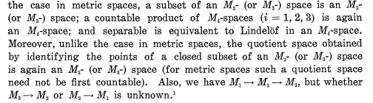
Generalizations of Metric Spaces

Slide 4
Generalizations of Metric Spaces
A regular space is metrizable if and only if it has a σ-locally finite base.
Recall that a σ-locally finite family is a union of countably many locally finite families
It is easily checked that a locally finite family U of sets has the property, called closure preserving, that for any Vcz U, (U{Fe F})-= U{F: Ve V} .

Slide 5
Generalizations of Metric Spaces
we consider spaces having a σ-closure preserving base (that is, a base which is the union of countably many closure preserving families).

Slide 6
Generalizations of Metric Spaces
An MΊ-space is a regular space having a σ-closure preserving base
Although conceptually simple, Mi-spaces prove unsatisfactory in some respects, so we weaken the condition of having a σ-closure preserving base.
We begin by calling a collection B of (not necessarily open!) sub_x0002_sets of X a quasi-base if, whenever x e X and U is a neighborhood of x, then there exists a B e B such that x e B° c B c U where JB° denotes the interior of B).

Slide 7

Generalizations of Metric Spaces
P is called σ-cushioned if it is the union of countable many cushioned sub collections.

Slide 8
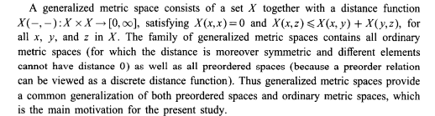

Slide 9
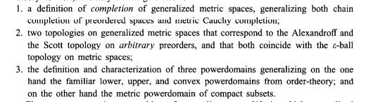

Slide 10
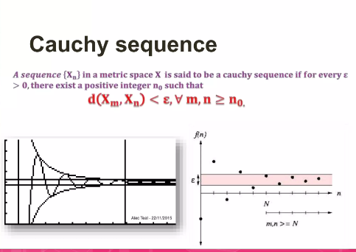

Slide 11
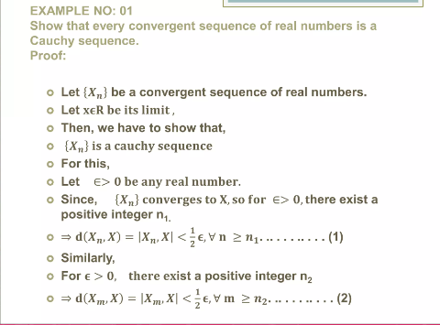

Slide 12
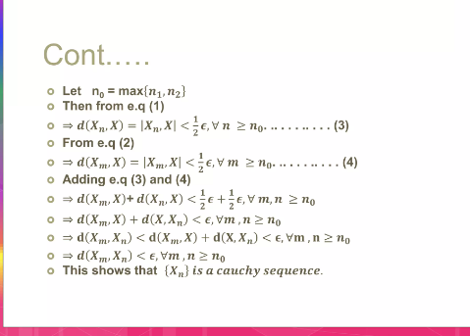

Slide 13
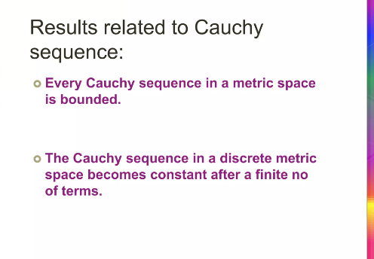

Slide 14
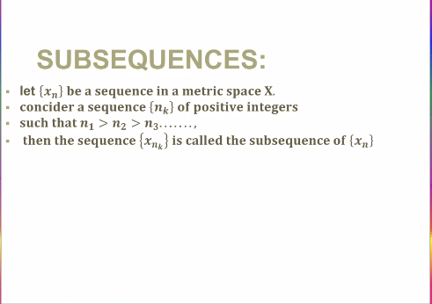

Slide 15
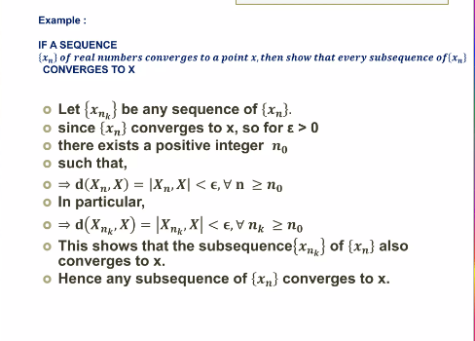

Slide 16
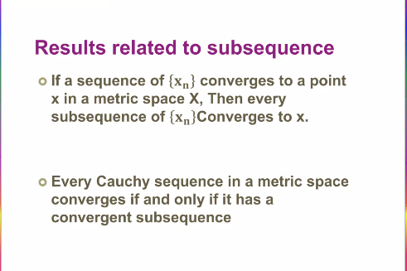

Slide 17
Compact Space
A topological space is compact if all sequences and more generally nets inside it converge as much as possible.

Slide 18
Compact Space
Compactness is a topological notion that was developed to abstract the key property of a subspace of a Euclidean space being “closed and bounded”: every net must accumulate somewhere in the subspace. (Roughly, the reason is that boundedness implies the net cannot escape the subspace, and the point to which it accumulates lies in the subspace by closure.

Slide 19
Locally Compact Spaces
A topological space X is locally compact at point x if there is some compact subspace X of X that contains a neighborhood of x. If X is locally compact at each of its points, set X is locally compact.

Slide 20
R is locally comapct since x ∈ R lies in neighborhood (x − 1, x + 1) which is in the compact space [x − 1, x + 1.

Slide 21
Similar to the argument of R, we have that R n is locally compact. For z ∈ R n , x is in the basis element (x1−1, x1+1)×(x2−1, x2+1)×· · ·×(xn−1, xn+1) which in turn is contained in compact subspace [x1 − 1, x1 + 1] × [x2 − 1, x2 + 1] × · · · × [xn − 1, xn + 1].
However, Rω = R × R × · · · under the product topology is not locally compact. Recall that basis elements for the product topology are of the form B = (a1, b1)×(a1, a2)× · · · ×(an, bn)×R×R× · · · (by Theorem 19.1).
If C is a compact subspace of R ω that contains x ∈ R ω and there is a neighborhood of x in C, then the neighborhood contains a basis element of the form of B. But then B = [a1, b1] × [a1, a2] × · · · × [an, bn] × R × R × · · · is a closed subspace of C and so would be compact by Theorem 26.2.
But B is not compact (consider an open cover which requires all of the open sets to cover one of the R components of B). So C cannot be compact and R ω is not locally compact.

Slide 22
Let X be a topological space. Then X is a locally compact Hausdorff space if and only if there is a topological space Y satisfying the following conditions:
(1) X is a subspace of Y .
(2) The set Y \ X consists of a single point.
(3) Y is a compact Hausdorff space. If Y and Y 0 are two spaces satisfying these conditions, then there is a homeomorphism of Y with Y 0 that equals the identity map on X.

Slide 23
Limit Point Compactness
A space X is limit point compact if every infinite subset of X has a limit point.

Slide 24
Limit Point Compactness
Let Y = {y1, y2} and let the topology on Y consist of ∅ and Y . Consider X = N×Y with the product topology where N has the discrete topology. Then for A ⊂ X, A 6= ∅, A has an element of the form (n, yi).
Any open set containing (n, yi) also contains the point (n, yj) where j = 3 − i, and so every nonempty A ⊂ X has a limit point and so X is limit point compact. However, X is not compact since the covering of X by the open sets Un = {n} × Y for n ∈ N has no subcollection covering X (and so no finite subcollection covering X)

Slide 25
Limit Point Compactness
Let X be a topological space. If {xn} ∞ n=1 is a sequence of points in X and if n1 < n2 < · · · < ni < · · · is an increasing sequence of natural numbers, then the sequence {yi} ∞ i=1 defined as yi = xni is a subsequence of the sequence {xn}. The space X is sequentially compact if every sequence of points of X has a convergent subsequence.

Slide 26
Limit point compactness implies countably compact.
Let us take an infinite sequence of nested closed sets and a point in each set; if the set of all points is finite, then the intersection is not empty and the proof is done. Otherwise, we get an infinite set A and therefore there is a limit point say x of A. If x is outside the intersection, then there is its neighborhood Ux of x such that Ux intersects only finitely many sets of the collection. Now by the T1-property we can find another neighborhood that does not contain any points of the sequence different from the limit point.

Slide 27
local compactness
A topological space X is locally compact at point x if there is some compact subspace X of X that contains a neighborhood of x. If X is locally compact at each of its points, set X is locally compact.

Slide 28
